Slide 1
Johnson County Hunger Relief Grant Blackbaud Instructions

Slide 2
Getting started with Blackbaud
Creating an account
Accessing the application
Uploading forms
Notes:
https://www.GrantRequest.com/SID_6256?SA=SNA&FID=35016

Slide 3
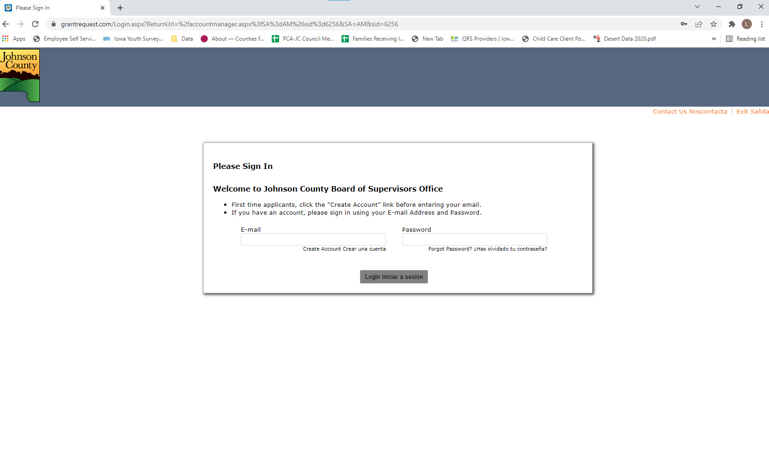
Notes:
You will receive a confirmation email to verify your account. All of your applications can be accessed through this account.

Slide 4
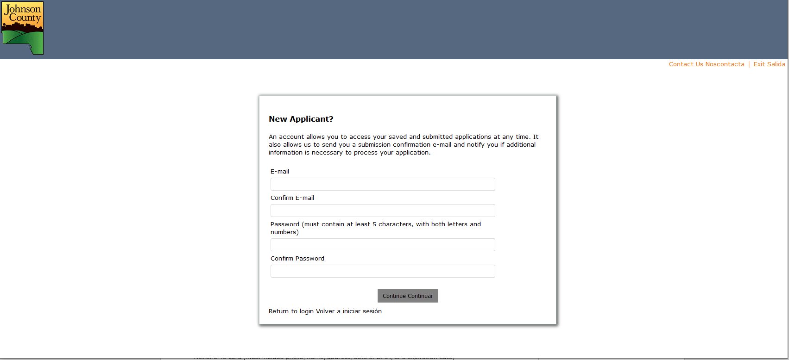

Slide 5
Notes:
Need to enter your agency’s Tax ID number to get started

Slide 6
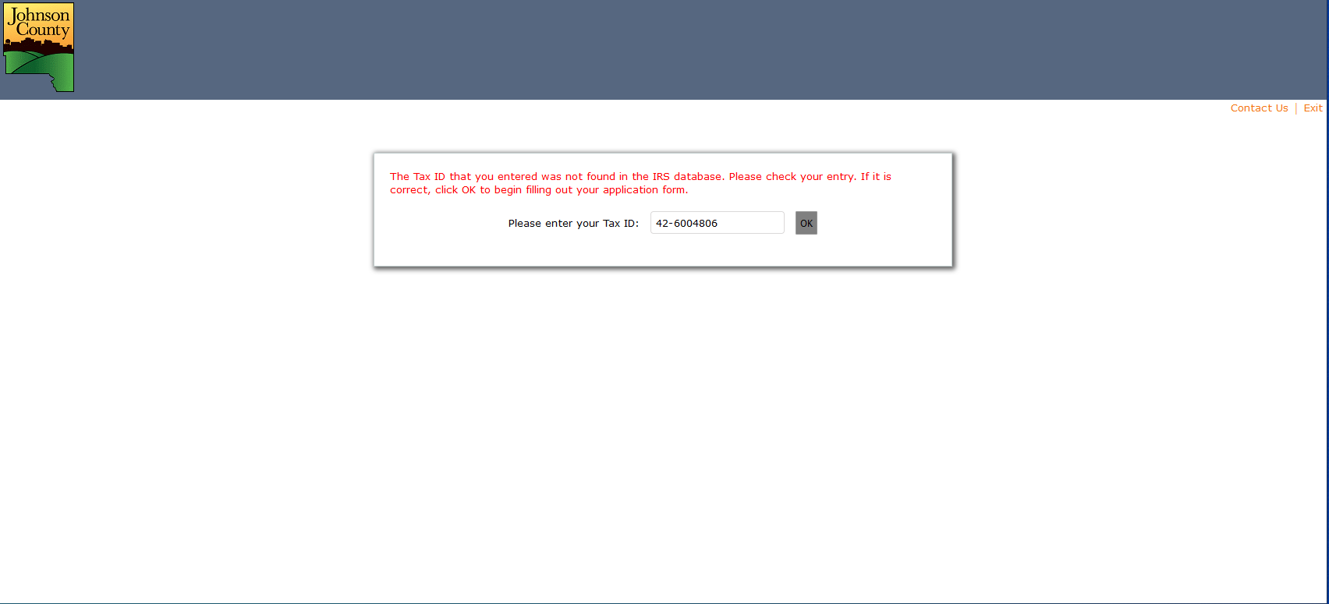

Slide 7
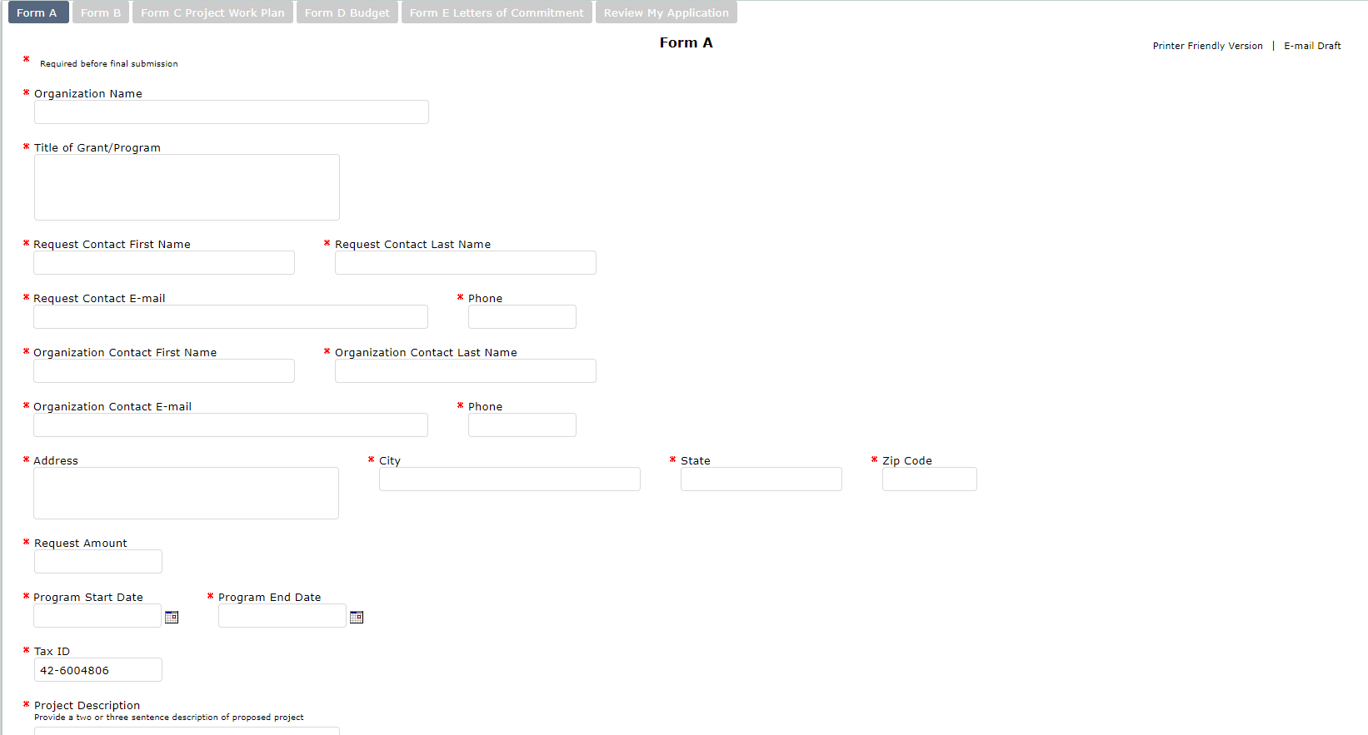
Notes:
Across the top you can see the different tabs of the application form
There is the option to print or to email a copy of the draft. Once you submit, a copy of your submitted application will automatically be emailed to you.
Form A asks for basic organization information, contact information, dollar amount requested, etc.

Slide 8
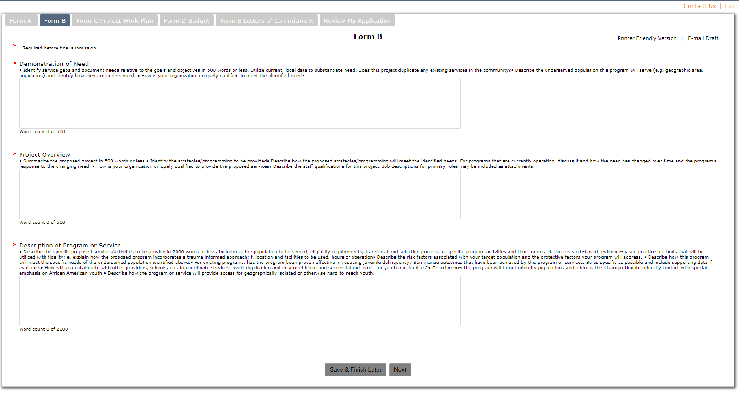
Notes:
Again, you can see each Form at the top. You can always go back to a previous form using this menu.
Form B includes the Demonstration of Need, Project Overview, and Program Description.
Demonstration of Need and Project Overview both have 500 word limits (around 1 page). You can see the word limits and how many words you’ve used.
Program Description has a 2000 word limit (around 4 pages).

Slide 9
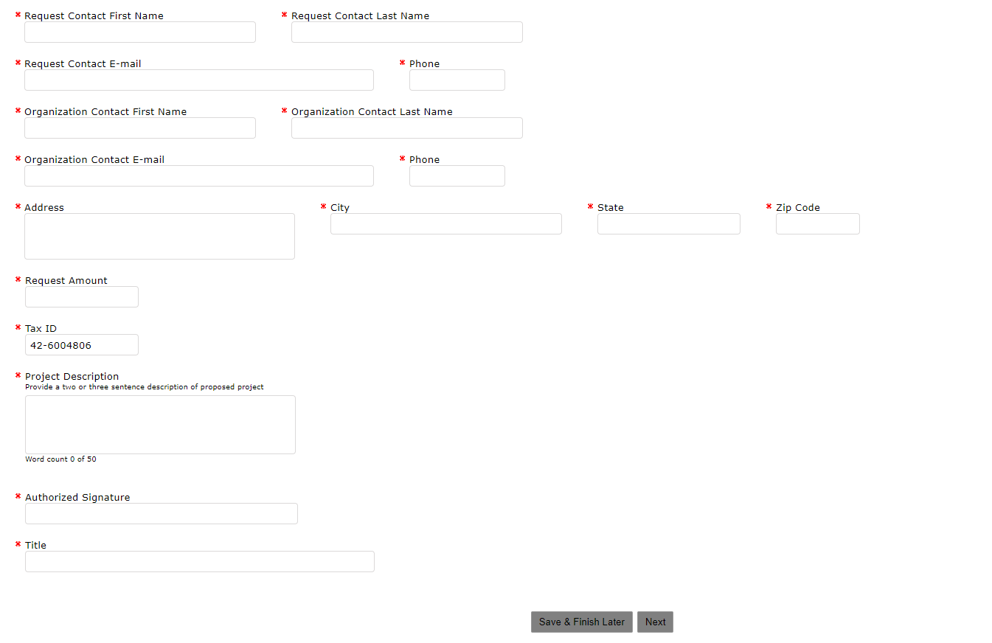
Notes:
In Form A, there is a character count limit in the Project Description. It is 50 words, which is about 2-3 sentences.
At the end of each Form are the options to Save & Finish Later or to go on to the Next form.

Slide 10
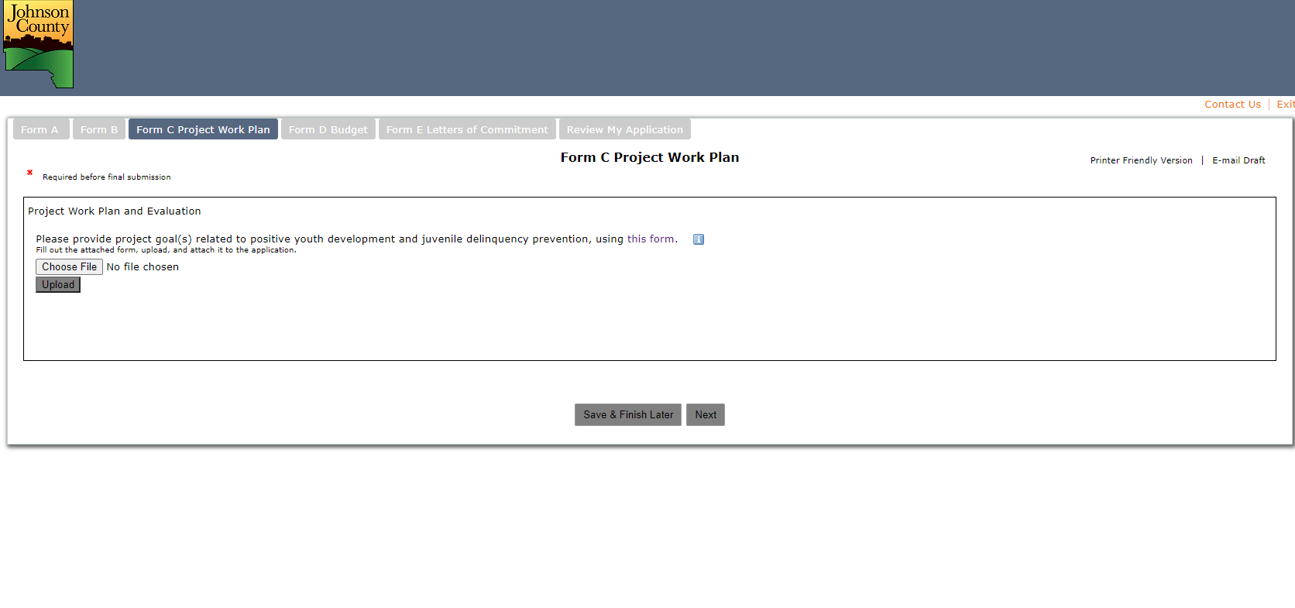
Notes:
Form C is the Project Work Plan. You will click on “this form” to download a copy of the Work Plan (on next slide).
From there, you will save to your computer, enter your information, and then click “Choose File” to upload the completed form.
After choosing your file, you must click “Upload” to upload it to the program.

Slide 11
FORM C
Project Work Plan and Evaluation
Form may be duplicated
EVALUATION
Provide a project goal related to positive youth development and juvenile delinquency prevention
SMART = Specific, Measurable, Achievable, Realistic, Timely
Objectives must be specific and measurable and related to the project goal
Activities must be specific
Performance Measures must be measureable and should include
- Output\Quantity: Numbers of activities/services provided and youth/families served
- Quality/Efficiency: Percentage of how well was it done
- Outcomes: Percentage of how are people better off
Objectives must be achievable by June 30, 2022.
Describe any measurement tools you will use to monitor progress and achievement of outcomes. Include when the tools will be utilized, who completes the tool, and how progress is measured. Specific tools may be included as attachments.
Notes:
https://www.GrantRequest.com/SID_6256?SA=SNA&FID=35016

Slide 12
Project Work Plan
Project Goal: ______________________________________________________________
SMART Objectives | Specific Activities | Performance Measures | Who is Responsible | Timeline
Notes:
https://www.GrantRequest.com/SID_6256?SA=SNA&FID=35016

Slide 13
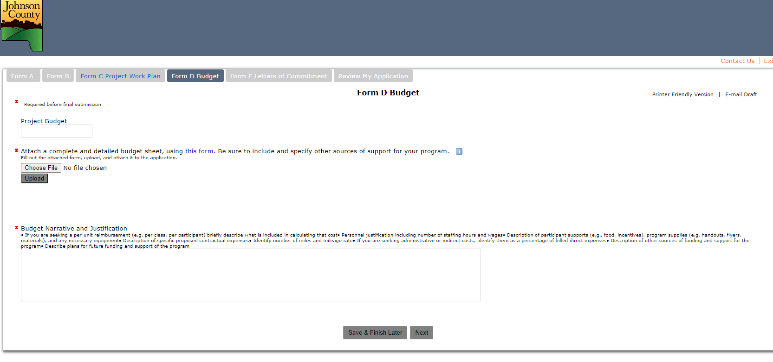
Notes:
Form D is the budget and justification. You will download the excel budget form by clicking where it says “this form”.
Save to your computer, enter your budget info, then Choose the completed file and Upload.
You must also complete the Budget Narrative. Please explain all budget items (ADD MORE HERE FROM THE RFP INSTRUCTIONS)

Slide 14
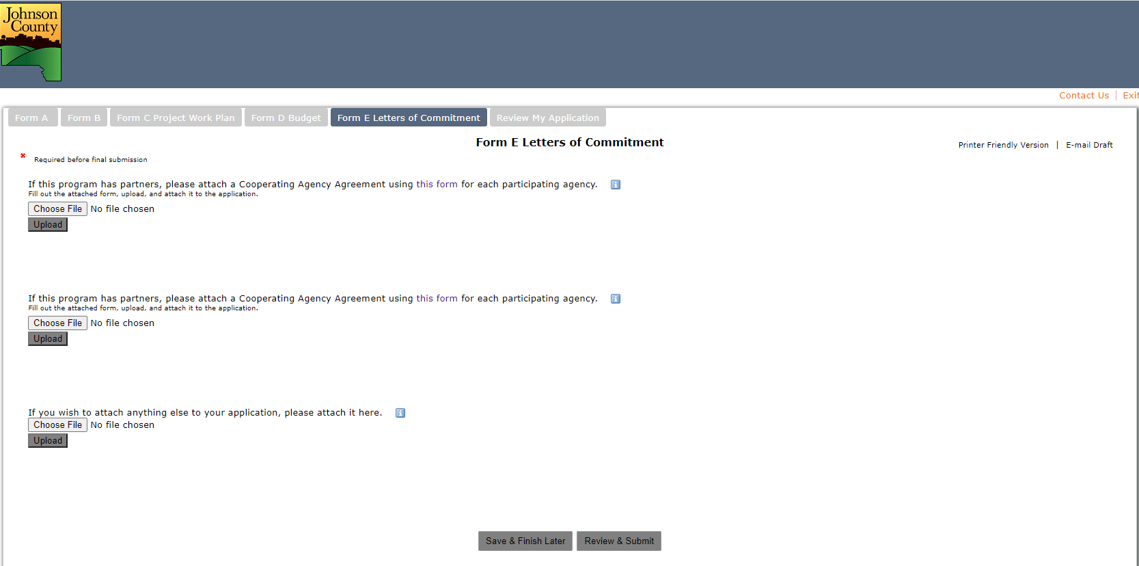
Notes:
If you are collaborating with other agencies, download and submit a Cooperating Agency Agreement for each partner agency. If there are more than 2 partner agencies, we will provide information about how to create a single document that includes multiple forms.
This is where you can upload additional supporting documents such as job descriptions, copies of evaluation tools, etc.
When you are finished, you can Save and Exit or you can Review your application before submitting.

Slide 15
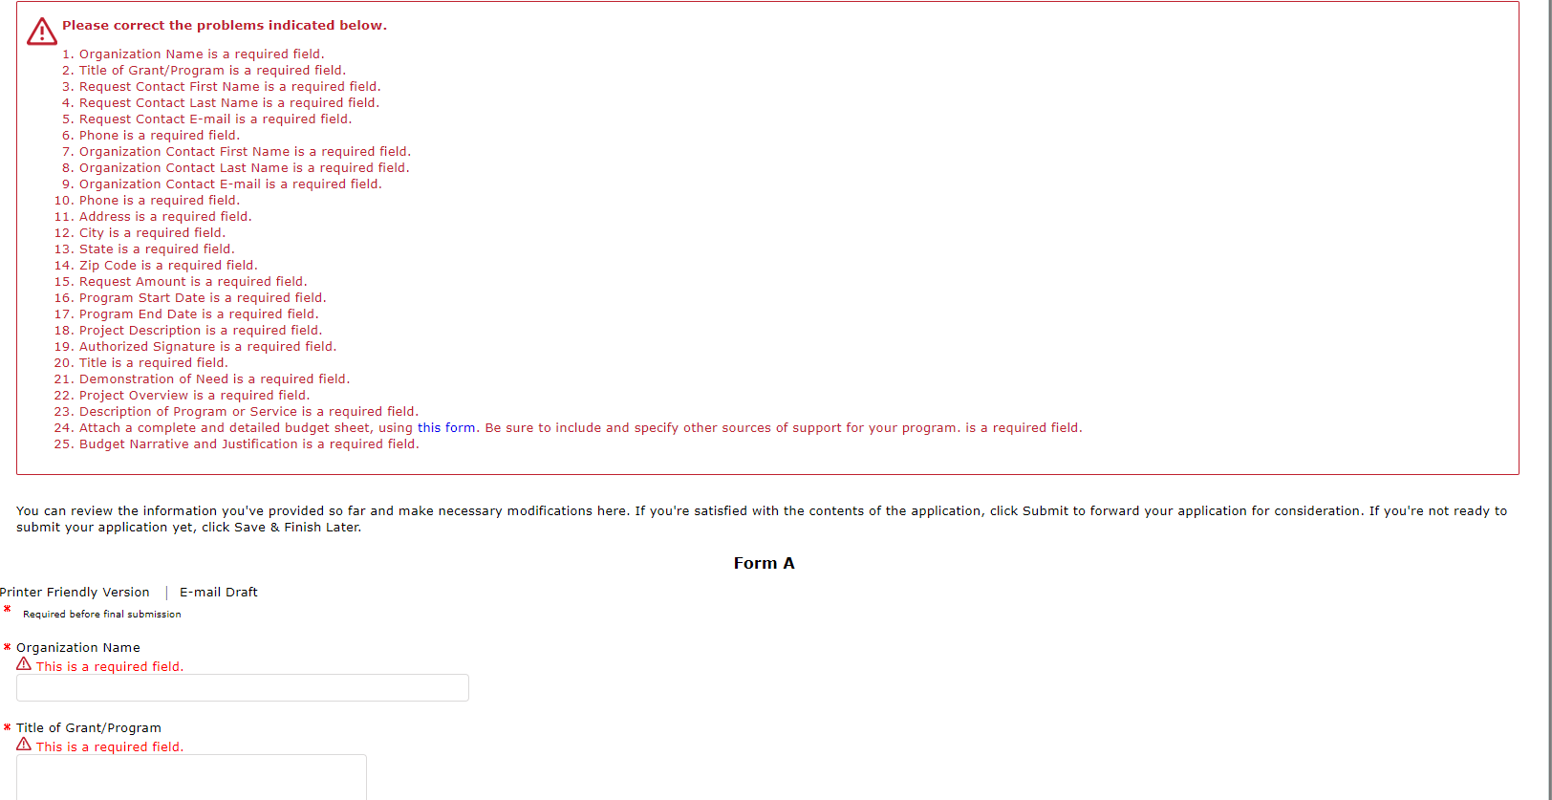
Notes:
In the Review screen, it will show you any errors that need to be corrected before you can submit. There is a list at the top and then each item will be identified.

Slide 16
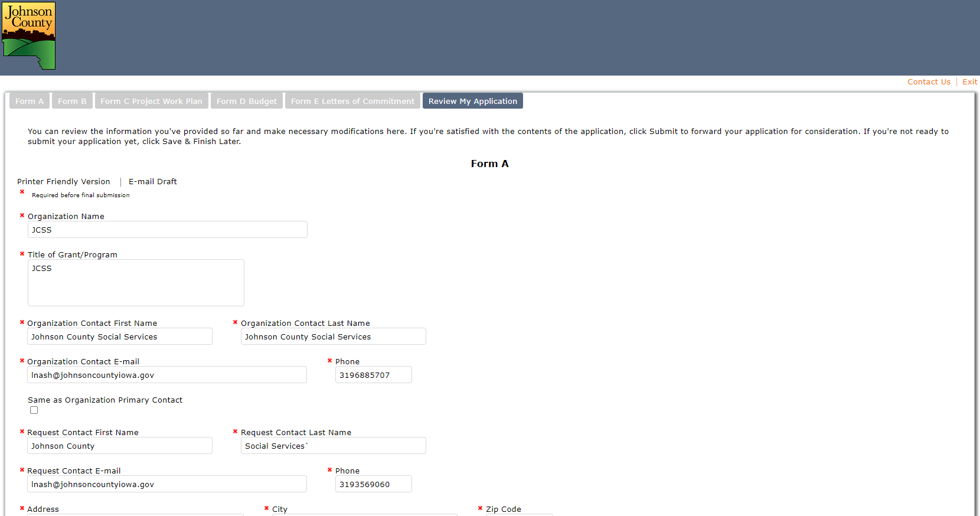
Notes:
If there are no errors or omissions, your Review page will look like this and you will have the opportunity to make changes before submitting.

Slide 17
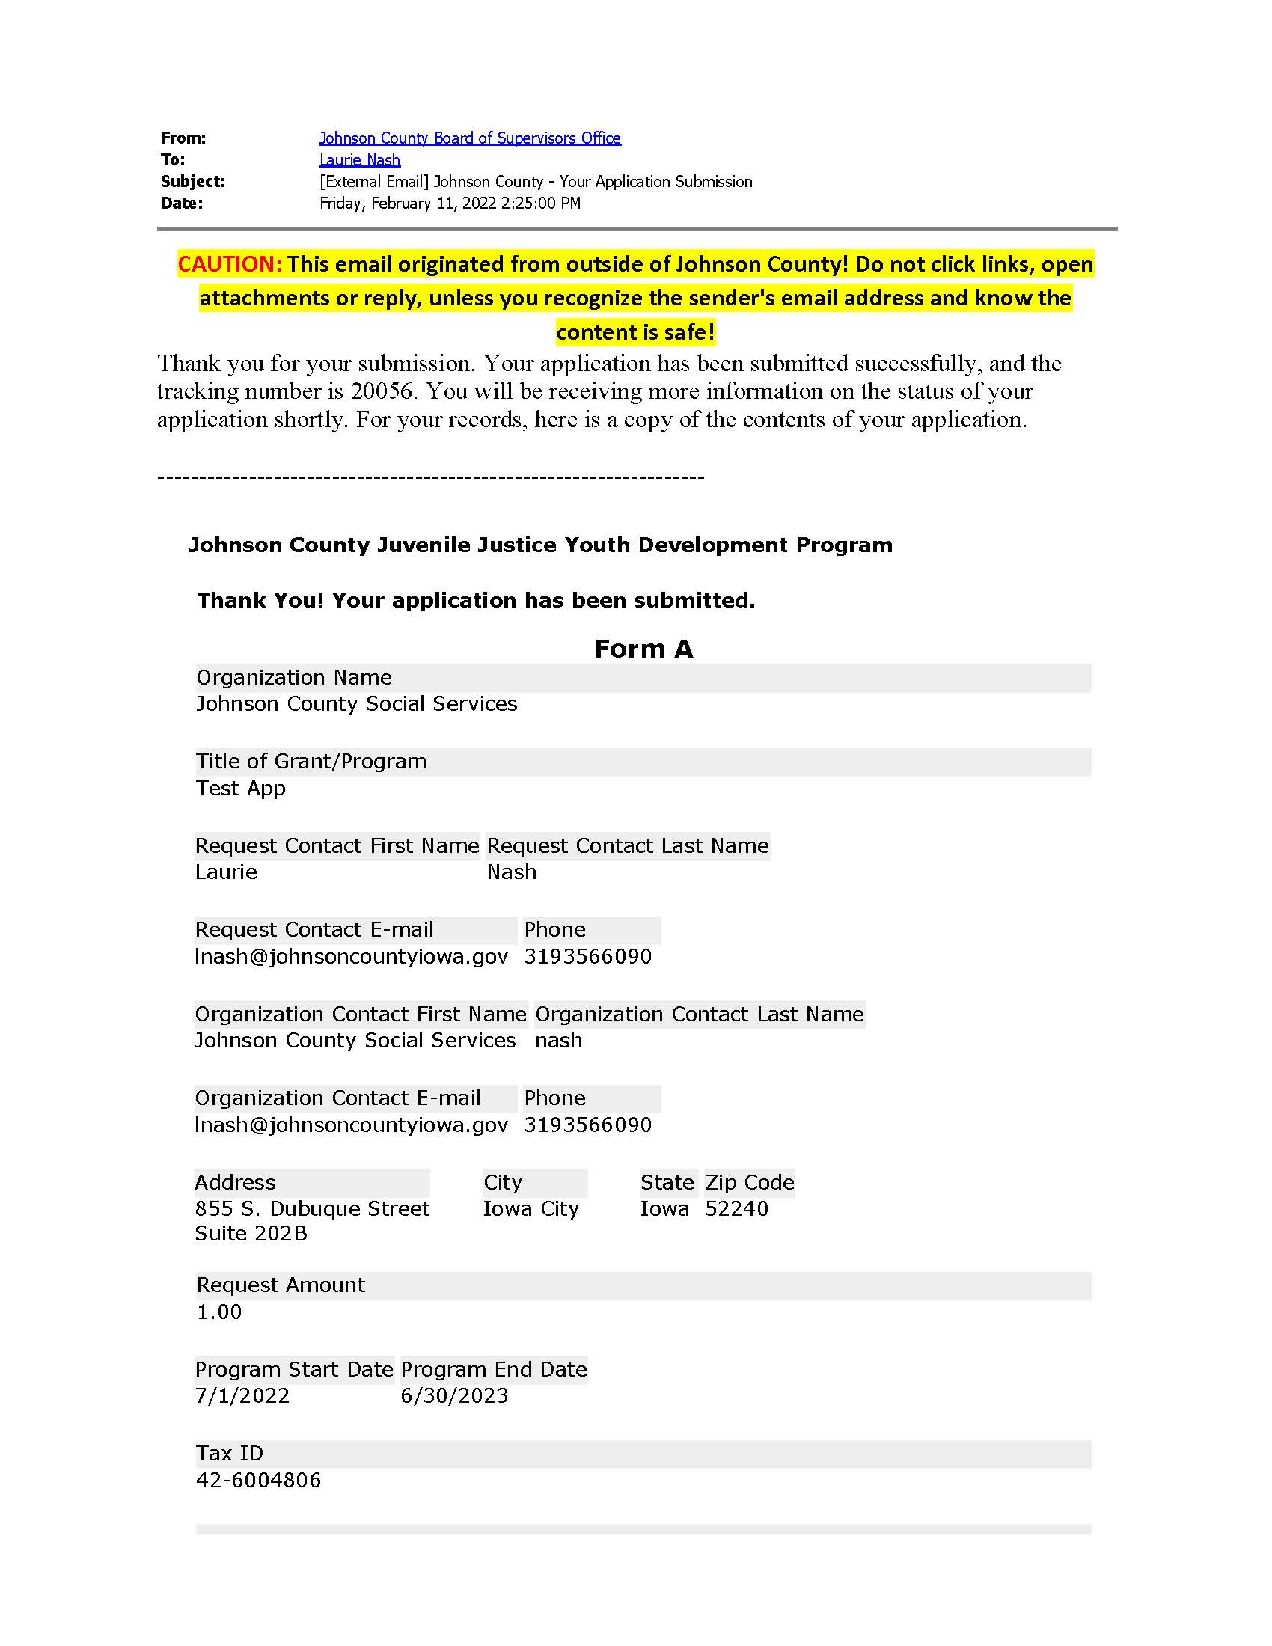
Notes:
After you submit your application, you will receive email verification that the application has been submitted. The email includes all of the information that was in your application.

